Slide 1
POTENCIA: CLASS 4
THURSDAY SEPTEMBER 10, 2020
8 – 9 PM

Slide 2
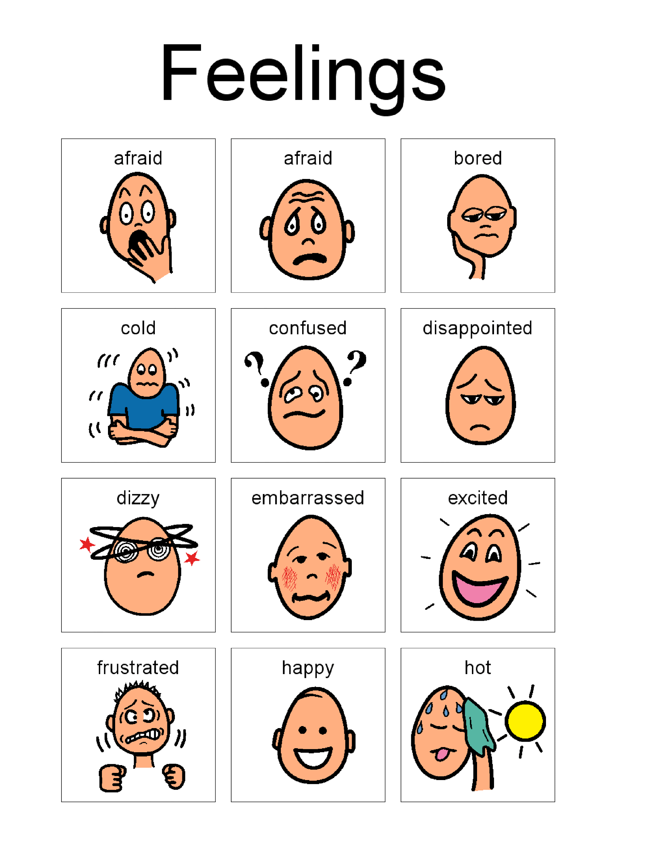
CHECKING IN
Emotions
HOW ARE YOU FEELING?
R: TODAY I FEEL ________
WHAT DID YOU DO TODAY?
R: TODAY I ________

Slide 3
REVIEW FROM LAST CLASS
WEATHER/TEMPERATURE, MONTHS, SEASONS:
WHAT MONTH IS IT?
WHAT MONTH COMES NEXT?
WHAT IS YOUR FAVORITE SEASON?
HOW WAS THE WEATHER TODAY?
THE 5 W’S + HOW: PLEASE TRANSLATE FROM ENGLISH TO PORTUGUESE
HOW
WHAT
WHERE
WHEN
WHY
WHO

Slide 4
PLAN FOR TODAY
REVIEW WHAT IS A NOUN
LEARN THE BASIC RULES OF FORMING A PLURAL NOUN
LEARN ABOUT ARTICLES IN ENGLISH
PRACTICE IDENTIFYING A NOUN IN A SENTENCE
PRACTICE IDENTIFYING THE CORRECT FORM OF A NOUN
Notes:
Noun, substativo

Slide 5
NOUNS
WHAT IS A NOUN?
Noun: person, place, or thing/object
NOUNS CAN BE SINGULAR OR PLURAL
Which group is made up of nouns?
Person
Mother/Father
Daughter/Son
Girl/Boy
Woman/Man
Doctor
Teacher
Place
Beach
School
House
Bakery
Medford
Thing/object
Computer
Shoe
Ear
Pencil
Book
Group A
Group B
Eyes
Snow
Hand
Mouth
Sun
See
Snowing
Touch
Eat
Sunny

Slide 6
QUICK ACTIVITY
IDENTIFY THE NOUN AND SAY IF IT IS A PERSON, PLACE, OR OBJECT.
TRANSLATE TO PORTUGUESE!
I have a son.
I am from brazil.
My eyes are tired.
The girl is here.
The pencil is red.
The tree is tall.
Notes:
eu tenho um filho
eu sou do Brasil
meus olhos estão cansados
a garota/menina está aqui
o lápis é Vermelho
a árvore é alta

Slide 7
TURNING A SINGULAR NOUN INTO A PLURAL NOUN: BASIC RULES
FOR MOST SINGULAR NOUNS, ADD ‘S’ AT THE END
Window 🡪 windows
Ear 🡪 ears
Eye 🡪 eyes
Hand 🡪 hands
FOR SINGULAR NOUNS THAT END IN CH, X, Z, S, SH, OR SS, ADD ‘ES’ AT THE END
Watch 🡪 watches
Bus 🡪 buses
Box 🡪 boxes
Moss 🡪 mosses
Notes:
Just because a word ends in “s” doesn’t mean it’s a plural noun

Slide 8
TURNING A SINGULAR NOUN INTO A PLURAL NOUN: BASIC RULES
FOR SINGULAR NOUNS THAT END IN F OR FE, CHANGE F TO ‘V’ AND ADD ‘ES’
Calf 🡪 calves
Wolf 🡪 wolves
Leaf 🡪 leaves
Life 🡪 lives

Slide 9
OTHER RULES
SOME NOUNS HAVE DIFFERENT PLURAL FORMS
NOUNS ENDING IN VOWELS LIKE Y OR O DO NOT HAVE DEFINITE RULES (SPELLING)
Baby 🡪 babies
Potato 🡪 potatoes
Toy 🡪 toys
A FEW NOUNS HAVE THE SAME SINGULAR AND PLURAL FORMS
Sheep
Fish
Series
Tooth 🡪 teeth
Goose 🡪 geese
Mouse 🡪 mice
Child 🡪 children
Woman 🡪 women
Man 🡪 men
Nouns that end in y: many times, remove y and replace with “ies”
Nouns that end in o: many times, remove o and replace with “oes”
Notes:
Bunny, berry, fly

Slide 10
SUMMARY OF RULES
Rule | Examples
1. For most nouns, add ‘s' | Cup 🡪 cups House 🡪 houses
2. For nouns that end in ch, x, s, or ss: Add ‘es’ | Glass 🡪 glasses Beach 🡪 beaches
3. For nouns that end in f or fe: Change f to ‘v’ and add ‘es’ | Knife 🡪 knives Wolf 🡪 wolves
4. Some nouns have different plural forms | Child 🡪 children Foot 🡪 feet
5. Nouns ending in y or o do not have definite rules (in spelling)* | Toy 🡪 toys Bunny 🡪 bunnies
6. A few nouns have the same singular and plural forms | Sheep Series

Slide 11
ARTICLES
WHAT IS AN ARTICLE?
*Articles tell us if something is specific (definite) or non-specific (non-definite)
They can also help us see if something is singular or plural
WHAT ARTICLES DO WE SEE IN ENGLISH?
The
Some
A
An
Definite; something particular
Indefinite; a general idea/thing

Slide 12


SUMMARY
Article | Translation | When to use | Examples
The | o/a | When referring to something specific (singular, plural, uncountable nouns) | Please bring the blue sweater that I like.
Some | algumos/as, un poco de… | When referring to something non-specific (plural, uncountable nouns) | I saw some sweaters at the store. Can I have some water?
A/An | um, uma | When referring to a general idea (singular nouns only) A 🡪 before a word that begins with a consonant An 🡪 usually before a word that begins with a vowel (a,e,i,o,u) | I am cold. Please bring me a sweater. Please bring me an orange sweater.
*There are some exceptions with A/An:
My mother is an honest woman.
My mother is a honest woman.
She is a United States senator.
She is an United States senator.
Notes:
English 🡪 doesn’t differentiate gender
Uncountable nouns 🡪 things that are too large to be counted (sand), intangible (information, air), or liquids (water, wine)
Some nouns can be countable or uncountable depending on the context
We need a light in this room
We need some light in this room

Slide 13
ACTIVITY 1: ARTICLES
IDENTIFY THE ARTICLE AND THE NOUN
IS THE ARTICLE DEFINITE OR INDEFINITE?
IS THE NOUN SINGULAR, PLURAL, OR UNCOUNTABLE?
Can you get me the pencil?
Please give me a cup of tea.
Are you going to the party?
Can you get me some water?
Some people like cold weather.
Translation
The | a/o
Some | algumos/as, un poco de…
A/An | um, uma

Slide 14
ACTIVITY 2: ABOUT BRAZIL
IDENTIFY THE CORRECT ARTICLE
Brazil is _____ largest country in South America and _____ fifth largest nation in the world. It forms _____ enormous triangle on the eastern side of the continent with a 4,500-mile (7,400-kilometer) coastline along _____ Atlantic ocean.
Northern brazil is dominated by _____ Amazon River and the jungles that surround it
Brazilians are soccer crazy, and their country has produced _____ of the best players.
Translation
The | a/o
Some | algumos/as, un poco de…
A/An | um, uma
Notes:
https://kids.nationalgeographic.com/explore/countries/brazil/

Slide 15
ACTIVITY 3: ARTICLES & NOUNS
IDENTIFY THE ARTICLES (IF THERE ARE ANY)
CHOOSE THE CORRECT FORM OF THE NOUN IN EACH SENTENCE:
I have three (child, children).
There are five (man, men) and one (woman, women).
I put two big (potato, potatoes) in the lunch box.
A few men wear (watch, watches).
I put a (note, notes) on the desk.
I saw a (mouse, mice) running by.
There are few (bus, buses) on the road today.

Slide 16
ACTIVITY 4: SINGULAR TO PLURAL NOUNS
IDENTIFY THE NOUN. THEN, CHANGE IT FROM SINGULAR TO PLURAL.
TRANSLATE THE SENTENCE!
My sweater is black.
My eye is brown.
My foot hurts.
The door is open.
Can I have some coffee?
Please turn off the light.
🡪 My sweaters are black.

Slide 17
LESSON SUMMARY
TODAY WE:
IDENTIFIED NOUNS IN A SENTENCE
PRACTICED CHANGING SINGULAR NOUNS TO PLURAL NOUNS
LEARNED ABOUT ARTICLES IN ENGLISH

Slide 18


CONTACT INFORMATION
BEVERLY.REYES@TUFTS.EDU
WHATSAPP: 203-550-4184
CLASSES ON THURSDAYS 8PM
Notes:
https://study.com/academy/lesson/singular-plural-nouns-definitions-rules-examples.html
https://www.lexico.com/grammar/plurals-of-nouns

